Slide 1
Course: Information Security
Razia Nisar
Message Authentication, MAC, Hash Function

Slide 2



Authentication
It is a process that allows node to verify the identity of the communicating node.
Two types of authentications
1)Entity authentication
2)Data authentication
Alice
Packet
secure
sender
secure
receiver
Bob
Alice receive
Packet
Packet
Sam

Slide 3
Authentication
Requirements - must be able to verify that:
1. Message came from apparent source or author,
2. Contents have not been altered,
3. Sometimes, it was sent at a certain time or sequence.
Protection against active attack (falsification of data and transactions)
Henric Johnson

Slide 4
Why Message Authentication?
Message authentication is important where undetected manipulation of messages can have disastrous effects.
Message authentication is a mechanism or service used to verify the integrity of
a message.
Message authentication assures that data received are exactly as sent
(i.e., there is no modification, insertion, deletion, or replay)

Slide 5
MESSAGE AUTHENTICATION FUNCTIONS
Message Encryption: The ciphertext of the entire message serves as its authenticator
Message Authentication Code (MAC): A function of the message and a secret
key that produces a fixed-length value that serves as the authenticator
Hash Function: A function that maps a message of any length into a fixed-length
hash value, which serves as the authenticator

Slide 6
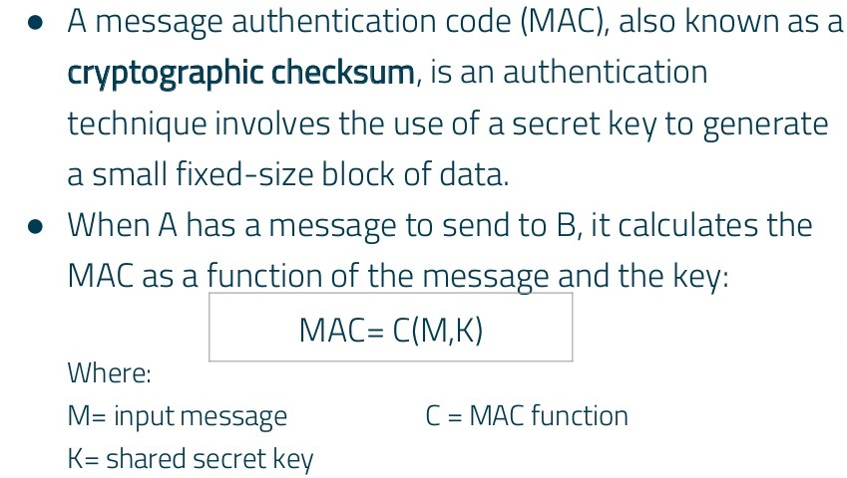
Message Authentication Code (MAC)

Slide 7
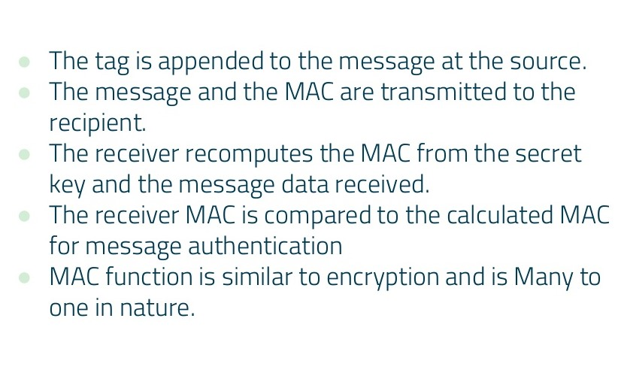
Message Authentication Code (MAC)

Slide 8
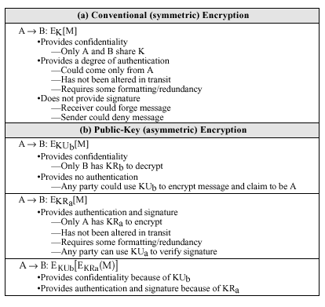
Message Authentication Using Plain Encryption

Slide 9
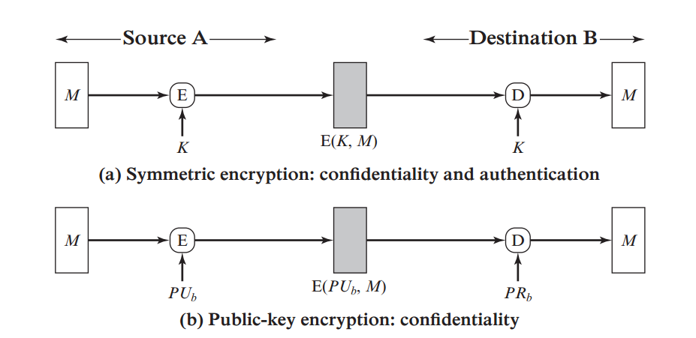
Message Encryption

Slide 10
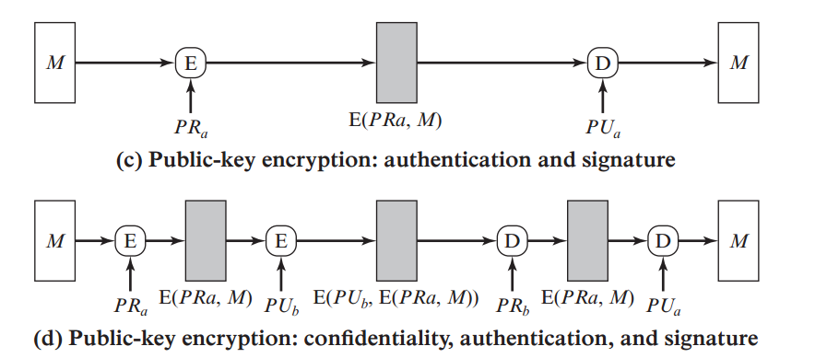
Message Encryption

Slide 11
Approaches to Message Authentication
Authentication Using Conventional Encryption
  Only the sender and receiver should share a key
Message Authentication without Message Encryption
  An authentication tag is generated and appended to each message
Message Authentication Code
  Calculate the MAC as a function of the message and the key. MAC = F(K, M)

Slide 12
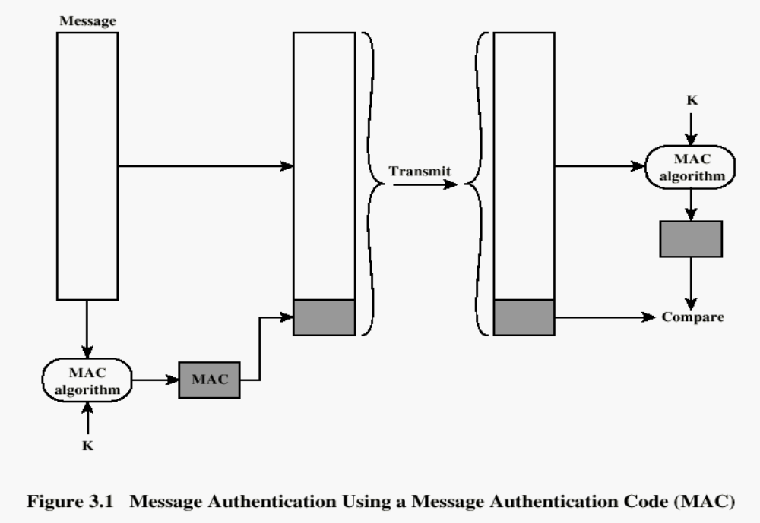
Message Authentication Code
Henric Johnson

Slide 13
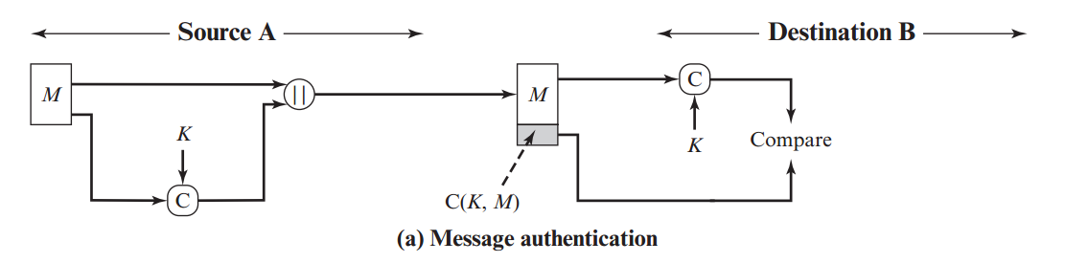
Message Authentication Code (MAC)

Slide 14
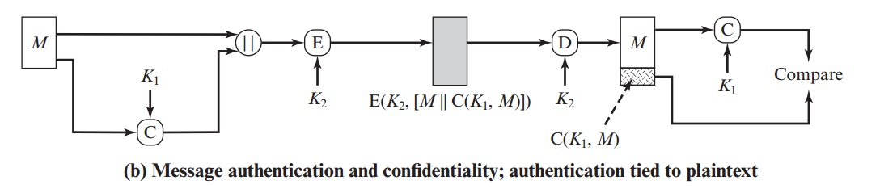
Message Authentication Code (MAC)

Slide 15
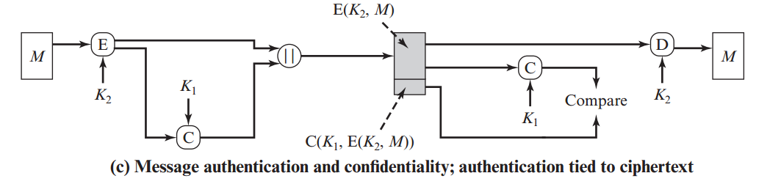
Message Authentication Code (MAC)

Slide 16
Use of a MAC
Used to provide
  Data integrity
  Message authentication
Secret key
MAC
algorithm
Secret key
message
MAC
verification
algorithm
Unsecured channel
Ok / not Ok
message
MAC
Signer
Verifier

Slide 17
Digital Signatures Scheme
Used to provide
  Data integrity
  Message authentication
  Non-repudiation
Note: RSA Algorithm is normally used for producing keys to create Digital Signature
Signer’s private key
Signing
algorithm
Signer’s public key
message
Signature
verification
algorithm
Unsecured channel
Ok / not Ok
message
signature
Signer
Verifier

Slide 18
Difference between MAC and digital signature
MAC values are both generated and verified using the same secret key
A digital signature is generated using the private key of a key pair (public-key cryptography)
To prove the validity of a MAC to a third party, you need to reveal the key
No need to communicate key in Digital Signature
If you can verify a MAC, you can also create it
Computing a MAC is (usually) much faster than computing a digital signature
  Important for devices with low computing power

Slide 19
Hash Function
A hash function H is a transformation that takes an input m and returns a fixed-size string, which is called the hash value h (that is, h = H(m)).
Hash functions with just this property have a variety of general computational uses.

Slide 20
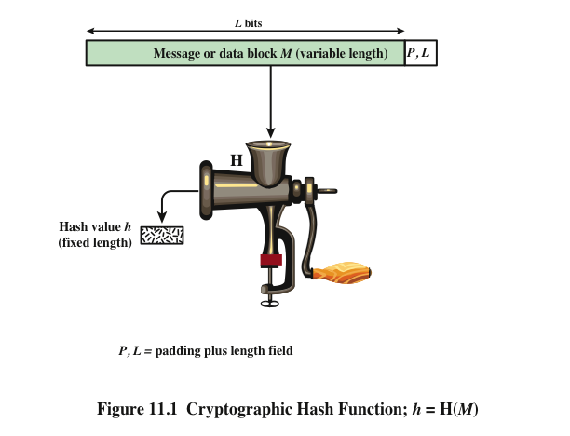
Notes:
Figure 11.1 depicts the general operation of a cryptographic hash function.
Typically, the input is padded out to an integer multiple of some fixed length
(e.g., 1024 bits), and the padding includes the value of the length of the original message
in bits. The length field is a security measure to increase the difficulty for an
attacker to produce an alternative message with the same hash value.

Slide 21
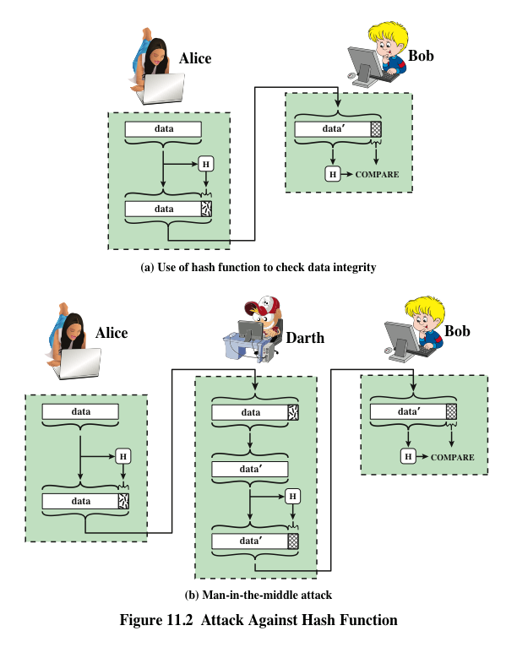
h= H(x)
H(x) = 2modx
H(5) = n mod 5
N =1,2,3,7
7
1
2
3
Notes:
Message authentication is a mechanism or service used to verify the integrity of
a message. Message authentication assures that data received are exactly as sent
(i.e., contain no modification, insertion, deletion, or replay). In many cases, there is
a requirement that the authentication mechanism assures that purported identity of
the sender is valid. When a hash function is used to provide message authentication,
the hash function value is often referred to as a message digest .
The essence of the use of a hash function for message authentication is as
follows. The sender computes a hash value as a function of the bits in the message
and transmits both the hash value and the message. The receiver performs the same
hash calculation on the message bits and compares this value with the incoming
hash value. If there is a mismatch, the receiver knows that the message (or possibly
the hash value) has been altered (Figure 11.2a).
The hash function must be transmitted in a secure fashion. That is, the hash
function must be protected so that if an adversary alters or replaces the message,
it is not feasible for adversary to also alter the hash value to fool the receiver. This
type of attack is shown in Figure 11.2b. In this example, Alice transmits a data block
and attaches a hash value. Darth intercepts the message, alters or replaces the data
block, and calculates and attaches a new hash value. Bob receives the altered data
with the new hash value and does not detect the change. To prevent this attack, the
hash value generated by Alice must be protected.

Slide 22
Using Hash Functions for Message Integrity
Method 1: Uses a Hash Function h, assuming an authentic (adversary cannot modify) channel for short messages
  Transmit a message M over the normal (insecure) channel
  Transmit the message digest h(M) over the secure channel
  When receiver receives both M’ and h, how does the receiver check to make sure the message has not been modified?
This is insecure. How to attack it?
A hash function is a many-to-one function, so collisions can happen.
Notes:
An authenticated channel for short messages bootstraps authenticity.
A short secret key in encryption boostraps confidentiality.

Slide 23
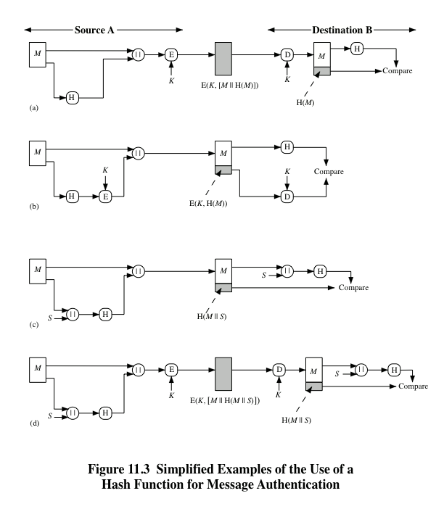
Notes:
Figure 11.3 illustrates a variety of ways in which a hash code can be used to
provide message authentication, as follows:
a. The message plus concatenated hash code is encrypted using symmetric
encryption. Because only A and B share the secret key, the message must
have come from A and has not been altered. The hash code provides the structure
or redundancy required to achieve authentication. Because encryption is
applied to the entire message plus hash code, confidentiality is also provided.
b. Only the hash code is encrypted, using symmetric encryption. This reduces the
processing burden for those applications that do not require confidentiality.
c. It is possible to use a hash function but no encryption for message authentication.
The technique assumes that the two communicating parties share a common secret
value S. A computes the hash value over the concatenation of M and S and
appends the resulting hash value to M. Because B possesses S, it can recompute
the hash value to verify. Because the secret value itself is not sent, an opponent
cannot modify an intercepted message and cannot generate a false message.
d. Confidentiality can be added to the approach of method (c) by encrypting the
entire message plus the hash code.
When confidentiality is not required, method (b) has an advantage over
methods (a) and (d), which encrypts the entire message, in that less computation
is required. Nevertheless, there has been growing interest in techniques that
avoid encryption (Figure 11.3c). Several reasons for this interest are pointed out in
[TSUD92].
• Encryption software is relatively slow. Even though the amount of data to be
encrypted per message is small, there may be a steady stream of messages into
and out of a system.
• Encryption hardware costs are not negligible. Low-cost chip implementations
of DES are available, but the cost adds up if all nodes in a network must have
this capability.
• Encryption hardware is optimized toward large data sizes. For small blocks
of data, a high proportion of the time is spent in initialization/invocation
overhead.
• Encryption algorithms may be covered by patents, and there is a cost associated
with licensing their use.

Slide 24
Requirements for Cryptographic Hash Functions
The basic requirements for a cryptographic hash function are as follows.
  The input can be of any length.
  The output has a fixed length.
  H(x) is relatively easy to compute for any given x.
  H(x) is one-way.
  H(x) is collision-free.
h->H(x)

Slide 25
Security Requirements for Cryptographic Hash Functions
Given a function h:X →Y, then we say that h is:
preimage resistant (one-way):
if given y ∈Y it is computationally infeasible to find a value x ∈X s.t. h(x) = y
2-nd preimage resistant (weak collision resistant):
if given x ∈ X it is computationally infeasible to find a value x’ ∈ X, s.t. x’≠x and h(x’) = h(x)
collision resistant (strong collision resistant):
if it is computationally infeasible to find two distinct values x’,x ∈ X, s.t. h(x’) = h(x)

Slide 26
H(x) is one-way ...
A hash function H is said to be one-way if it is hard to invert, where ``hard to invert'' means that given a hash value h, it is computationally infeasible to find some input x such that H(x) = h.

Slide 27
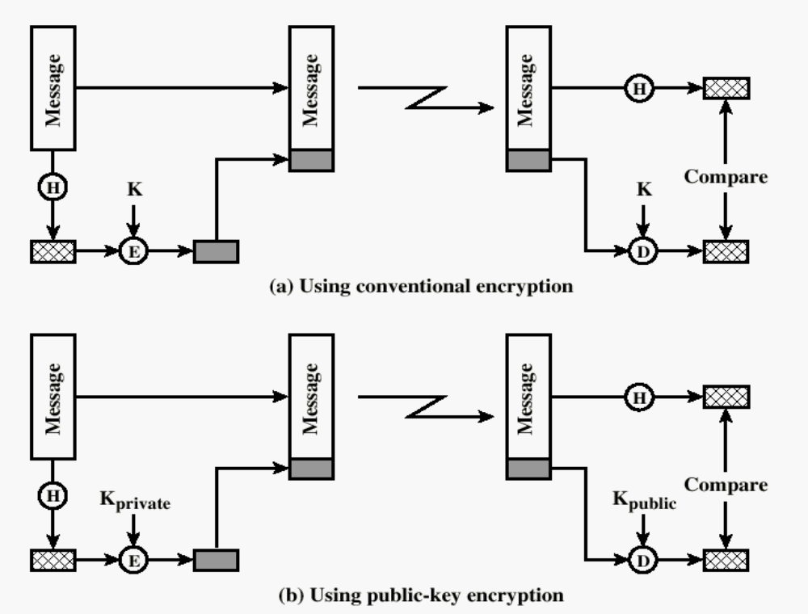
One-way HASH function
Henric Johnson

Slide 28
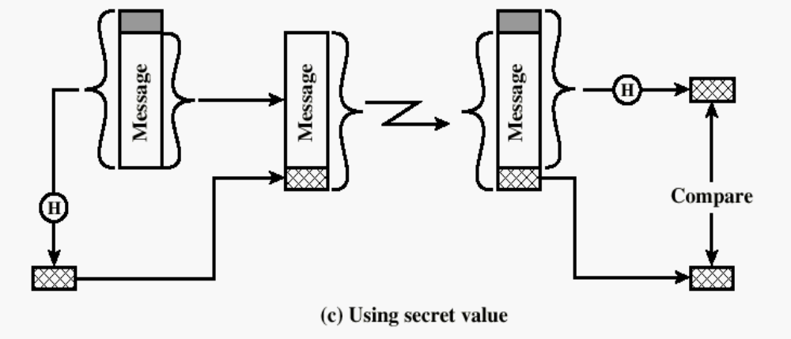
One-way HASH function
Secret value is added before the hash and removed before transmission.
Henric Johnson

Slide 29
Hash Functions as Message Digests
The hash value represents concisely the longer message or document from which it was computed; this value is called the message digest.
One can think of a message digest as a ``digital fingerprint'' of the larger document.
Examples of well known hash functions are MD5 and SHA.

Slide 30
Hash Function
The sender computes a hash value as a function of the bits in the message and transmits both the hash value and the message.
The receiver performs the same hash calculation on the message bits and compares this value with the incoming hash value.
If there is a mismatch, the receiver knows that the message (or possibly the hash value) has been altered.

Slide 31
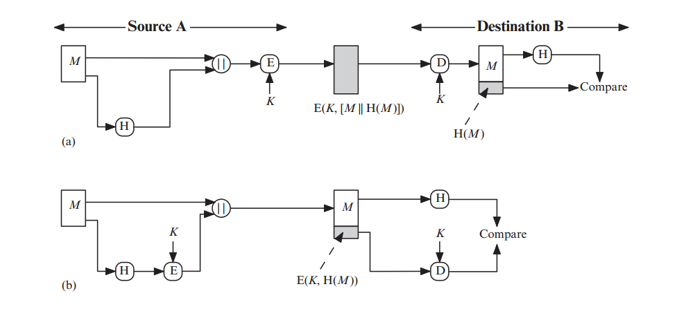

Hash Function

Slide 32
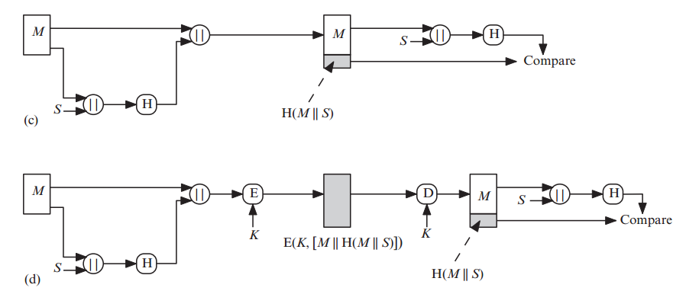

Hash Function

Slide 33
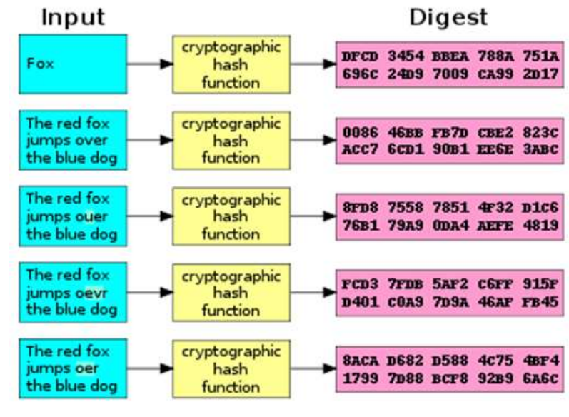
Hash Function

Slide 34

Secure HASH Functions
Purpose of the HASH function is to produce a ”fingerprint.
Properties of a HASH function H :
  H can be applied to a block of data at any size
  H produces a fixed length output
  H(x) is easy to compute for any given x.
  For any given block x, it is computationally infeasible to find x such that H(x) = h
  For any given block x, it is computationally infeasible to find with H(y) = H(x).
  It is computationally infeasible to find any pair (x, y) such that H(x) = H(y)

Slide 35
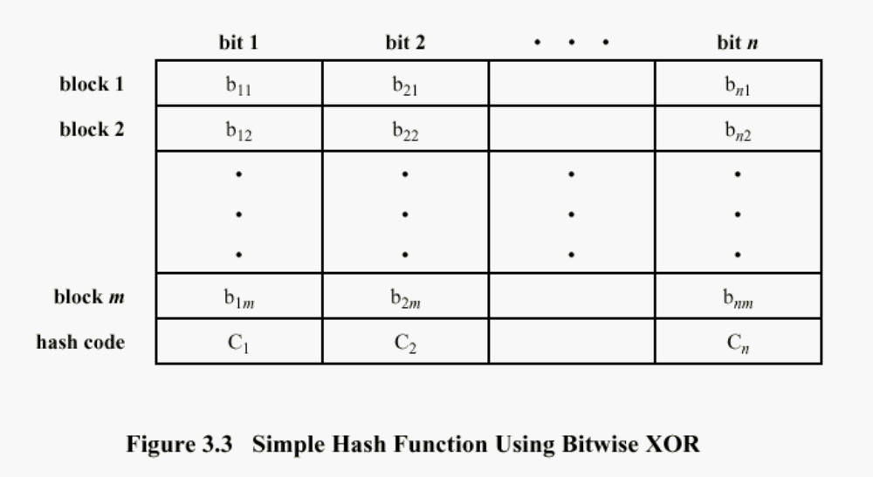
Simple Hash Function
One-bit circular shift on the hash value after each block is processed would improve

Slide 36
Well Known Hash Functions
MD5
  output 128 bits
  collision resistance completely broken by researchers in China in 2004
SHA1
  output 160 bits
  no collision found yet, but method exist to find collisions in less than 2^80
  considered insecure for collision resistance
  one-wayness still holds
SHA2 (SHA-224, SHA-256, SHA-384, SHA-512)
  outputs 224, 256, 384, and 512 bits, respectively
  No real security concerns yet

Slide 37
Summary
Approaches to Message Authentication
MAC
Digital Signature
Secure Hash Function
Comparison

